Slide 1
Profitability Analysis-II
Chapter 23
ChEN 4253
Terry A. Ring

Slide 2
Measures of Profitability
Return on Investment (ROI)
  ROI=annual earnings/capital investment
  ROI > cost of capital (commercial interest rate, i)
Payback period (PBP)
Annualized Cost (C_{A})
Venture profit (VP)
Investor’s Rate of Return (IRR)
Discounted Cash Flow Rate of Return (DCFR)
Hard work to get this all together
Same

Slide 3
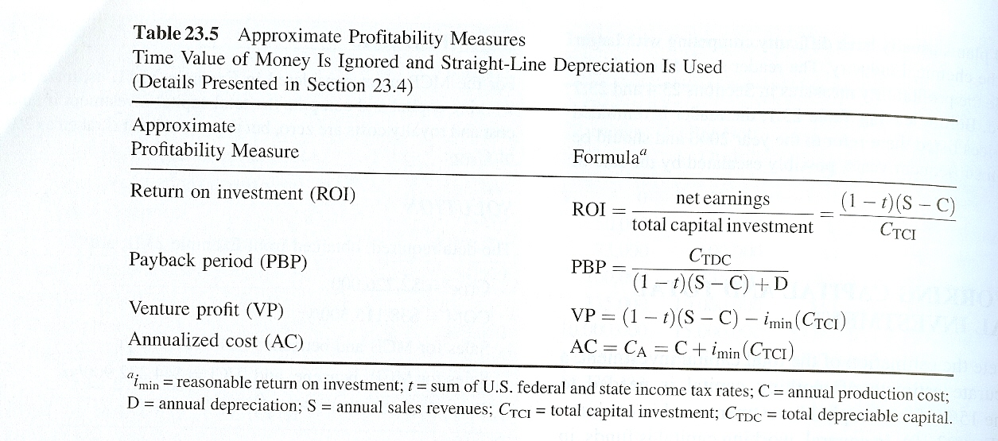
Definitions of Profitability Measures

Slide 4
How to determine ROI
Sales revenue minus Costs
  Cost of feedstocks
  Cost of Utilities
  Cost of Labor and Maintenance
  Cost of Overhead
  Cost of Taxes and Insurance
  Cost of Depreciation
  Cost of sales force, R&D, Admin., Management Incentives

Slide 5
Utilities
Steam
Electricity
Cooling Water
Process Water
  Boiler Water
  Feed Stock water/Steam
Refrigeration
Fuels
  Natural Gas
  Fuel Oil
  Coal
Waste Treatment
  Stack Gas Cleanup
  Waste Water Treatment
Land fill cost for solid waste

Slide 6
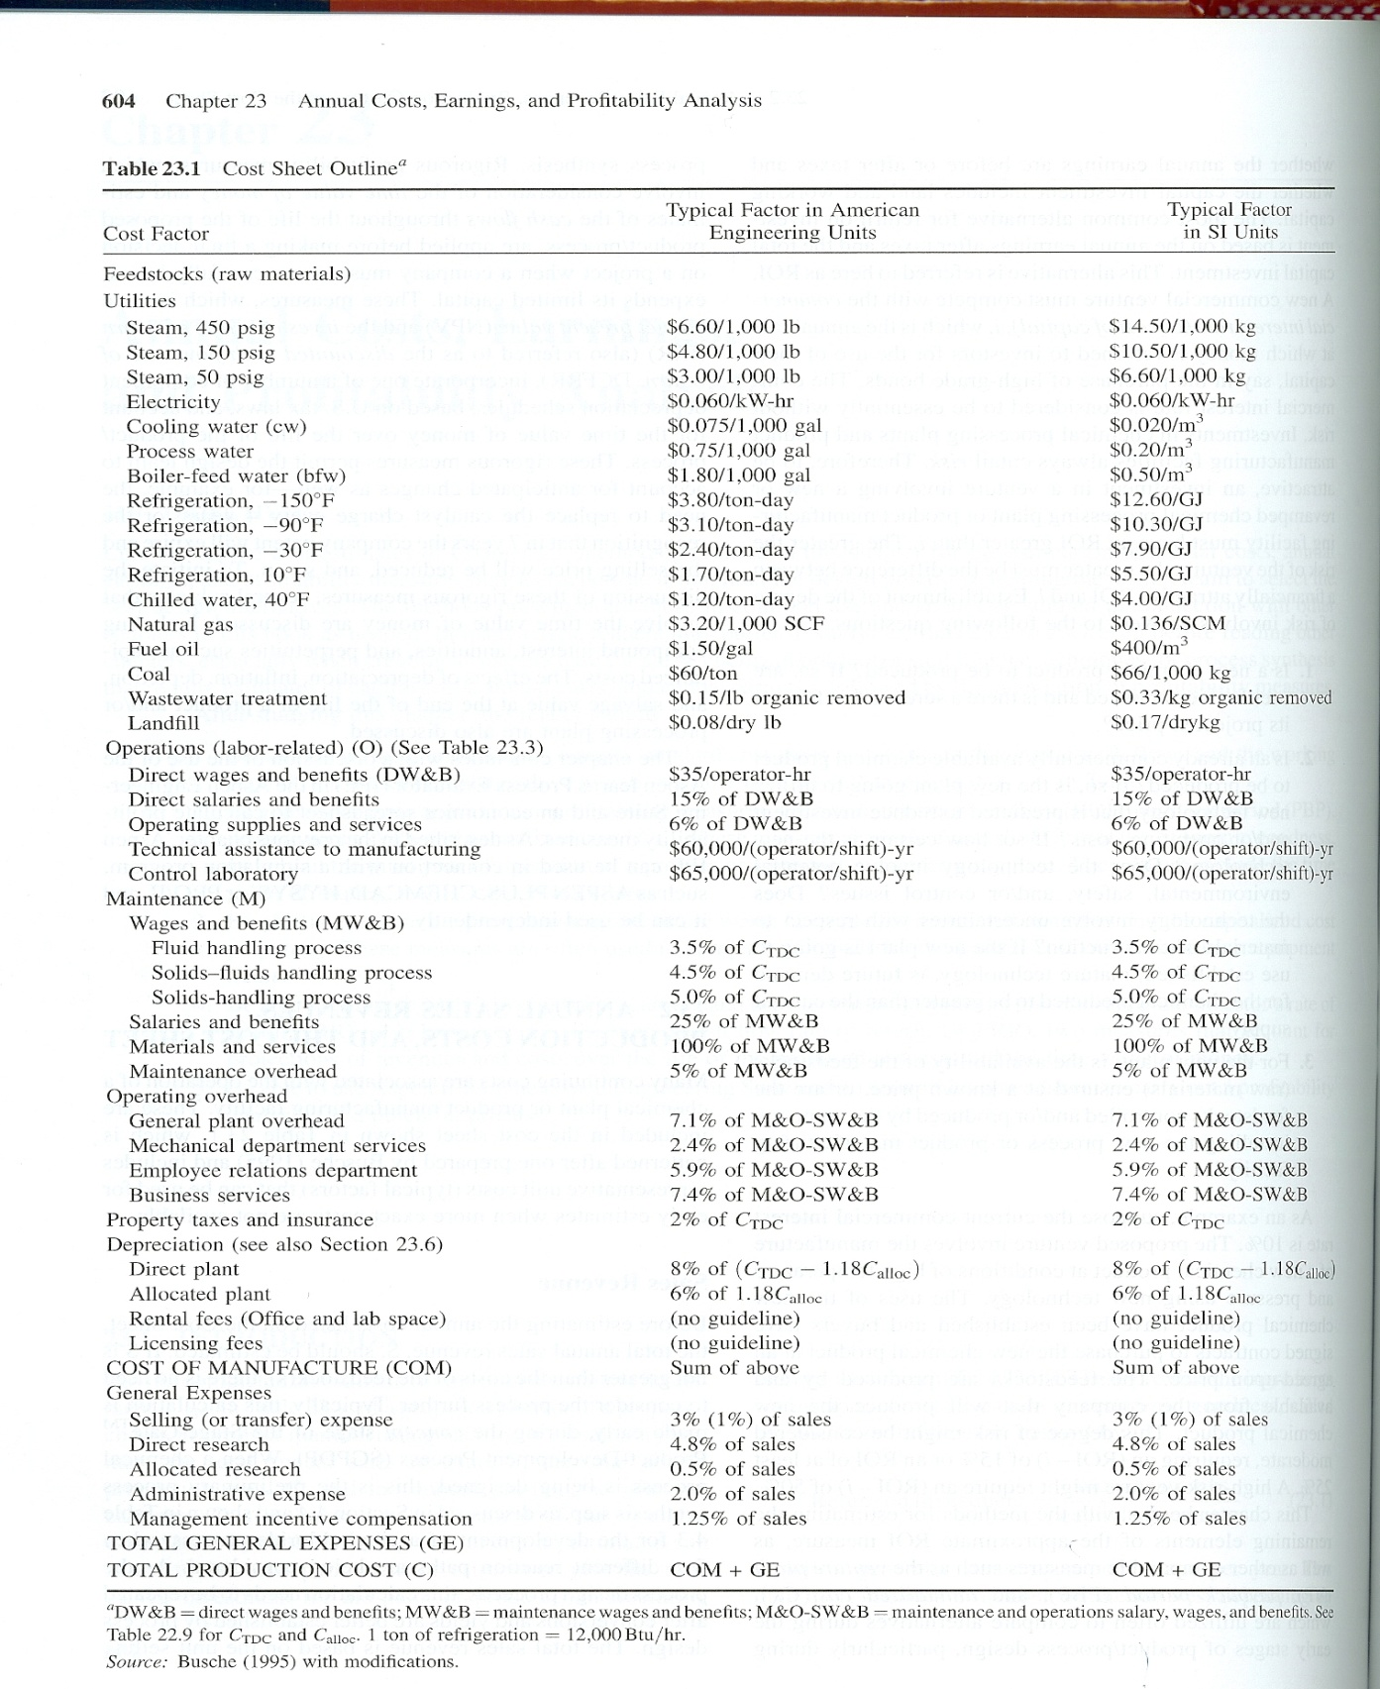
Costs

Slide 7
Depreciation
Straight-line Depreciation
  Equipment Lifetime – Plant = 12 yr
  Constant % each year so that plant is totally written off at end of life time
    8% of Total Depreciable Capital, C_{TDC}
  What would be the depreciation % for 20 yr lifetime?
Other types of depreciation
  Accelerated Cost Recovery System (ARCS)
  Modified Accelerated Cost Recovery System (MARCS) for Taxes
  Declining-Balance Method (DB)
  Double Declining-Balance Method (DDB)
  Others

Slide 8
More On Depreciation
Declining Balance Method (no salvage value)
  d= range from 1/n to 2/n, typically use 1.5/n
Double Declining Balance Method (no salvage value)
  d=2/n
Depreciation amount for year t, D_{t}=B*d*(1-d)^{t-1}
Book Value after year t, BV_{t-1} =B(1-d)^{t-1}
  B=basis = C_{TDC}
  n= service life
  t=year

Slide 9
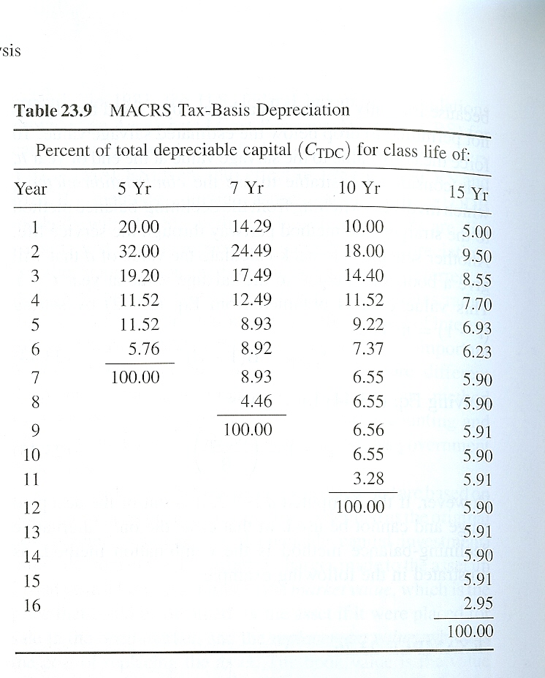
More On Depreciation
ACRS – Federal Tax Law 1982 – 1986
MACRS - Federal Tax Law in 1987
Accelerated Cost Recovery System

Slide 10
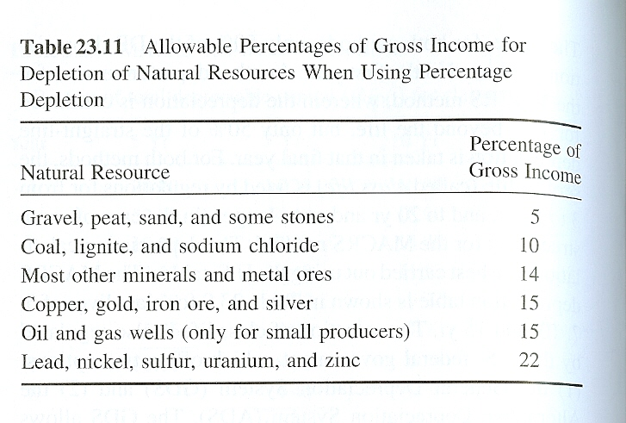
More on Depletion (of natural resource)
Cost Depletion = Units recovered this year*Unit value
  Unit Value =
  Cost to acquire resource/estimate of recoverable units
Percentage Depletion

Slide 11
Taxes
Property Taxes
  Based upon the value of the property
Used in Cost of Manufacturing
Severance Tax = 12.5% of extracted mineral’s net value
State Taxes
  Very between states, UT = 6.2%
Federal Income Tax for Business
  Typically taken to be 34% of gross earnings

Slide 12
Total Production Cost, C
Cost of Manufacturing minus general expenses
C=COM-General Expenses
General Expenses
  Selling expenses, R&D, Admin. (top management), Management Incentive Package

Slide 13
Cost of Manufacturing (COM)
Direct manufacturing costs
  Feedstocks, Utilities, labor related to operations, maintenance
Operating overhead
Fixed costs
  Property Tax, Insurance, Depreciation

Slide 14
Pre-tax (Gross) Earnings
Gross Earnings = Sales (S) – Total Productin Cost (C)
Net Earnings(Profit) = (1-t) Gross Earnings
  Tax (t) = State (UT=6.2%) + Federal taxes (34%)

Slide 15
Working Capital, C_{WC}
Typically 15 % C_{TCI}
More Accurate Working Capital Calculation
C_{WC}=Cash Reserves+Inventory+accounts receivable-accounts payable
Cash reserves - 30 days of raw materials, utilities, operations, Maintenance, operating overhead, property taxes, insurance and depreciation 8.33% of COM
Inventories = 7 days of products at sales prices
Accounts receivable - 30 days at sales price 8.33% of annual sales
Accounts payable – 30 days of feedstocks at purchase price, 8.33% of annual feed stock costs

Slide 16
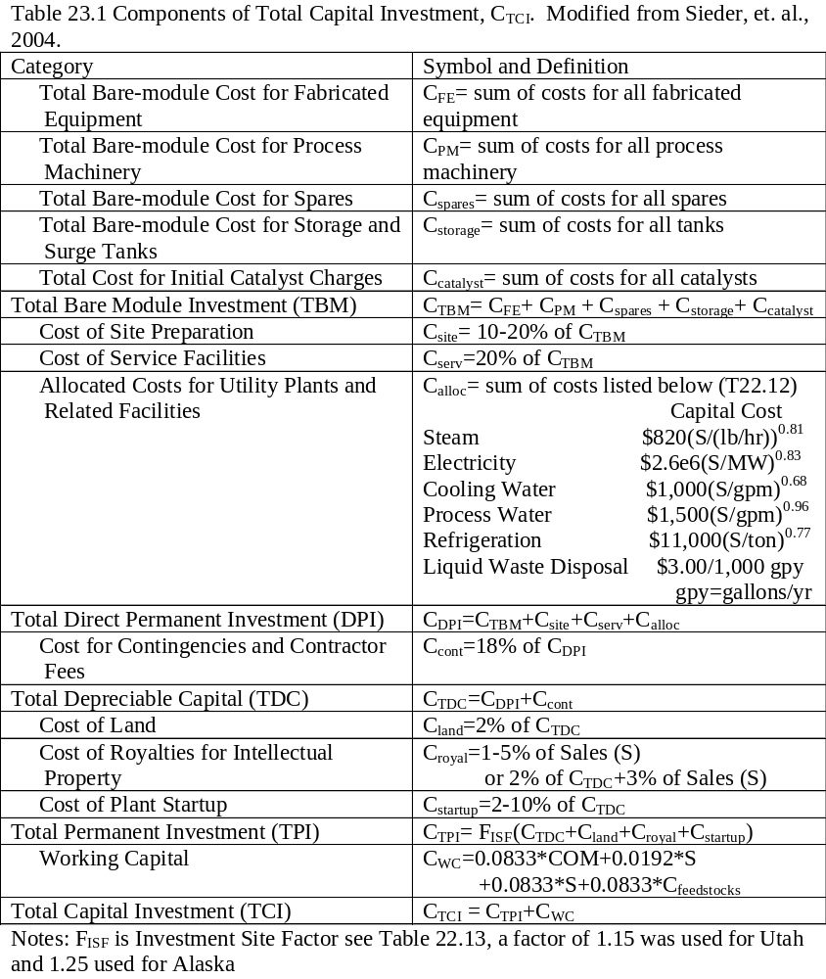

Slide 17
Definitions of Profitability Measures

Slide 18
Selling Price for Given ROI
For a new product without an established market
Sale price may very
  High Sales price
    Assume ROI say 40% (This is a home run!!)
    Back calculate the sales price.
  Low Sales price
    Set VP to Zero
    Back calculate the sales price
    (this is the same as ROI calc above when or i_{min} is 20%)

Slide 19
ROI is not good enough for cash poor companies
They use annual Cash flow
Years of Plant construction
  CF = -fC_{TDC}-C_{WC}-C_{land}
Years of Plant Operation
  CF = (1-t)(S-C)+D
Depreciation D=fC_{TDC}
f= fraction of TDC which is depreciated that year

Slide 20
Using Excel for Profitability Analysis
User name “student”
Password “engineer”
Steps to get ready
Get Chemical Prices
Get Cost of Utilities
Run Aspen/ProMax
  Production Rates (kg/y)
  Utilities used (kg/y)
Determine installed cost of equipment
Only then are you ready to use this spread sheet

